Slide 1

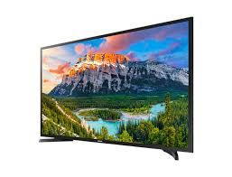
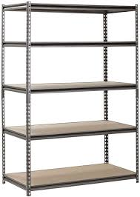



By Aric Rachmany and Tal Kabaso

Slide 2
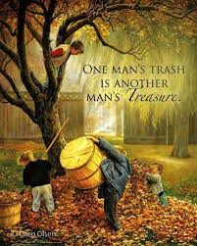
Project description
The number of participants is unlimited which increases the chances of finding an item that I like and increases the likelihood of an exchange.
Each user should tell his true preferences in order to increase his chances of getting one of the products he prefers.
Our project is an internet site written in Python (server-side) and JavaScript, Html, Css and JQuery (client-side). The site is providing a comfortable and user-friendly environment for everyone who wants to exchange anything with other users that wants what he offers by using the "trading cycles". The site suggest exchanging from various types of items like work shifts, personal items, vouchers and more.
Allow us to assure users that they cannot lose from participation.

Slide 3

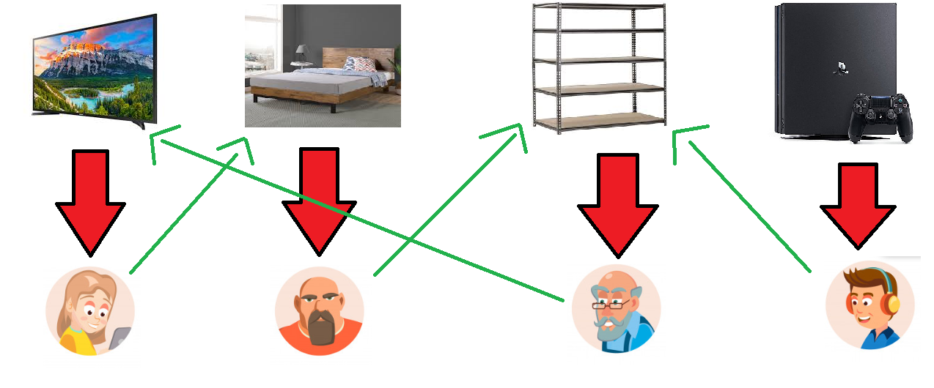
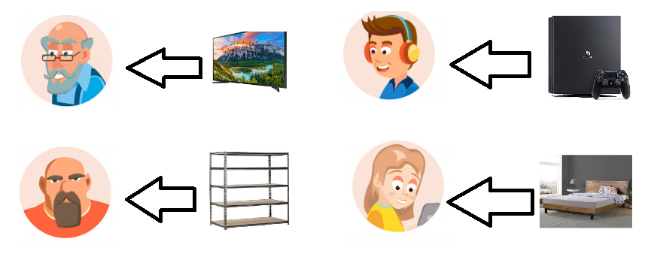
Why our site is better than other exchanging items sites?
Currently, there are interfaces that allow the exchange of items between 2 people, selling and buying products via the Internet, however in our site we allow users to get new items for them without the need of searching separately seller and buyer.
in addition there is no limit on the number of participants, thanks to the algorithm we use, that looks for as many swap circles as possible at each stage among all tender participants.

Slide 4
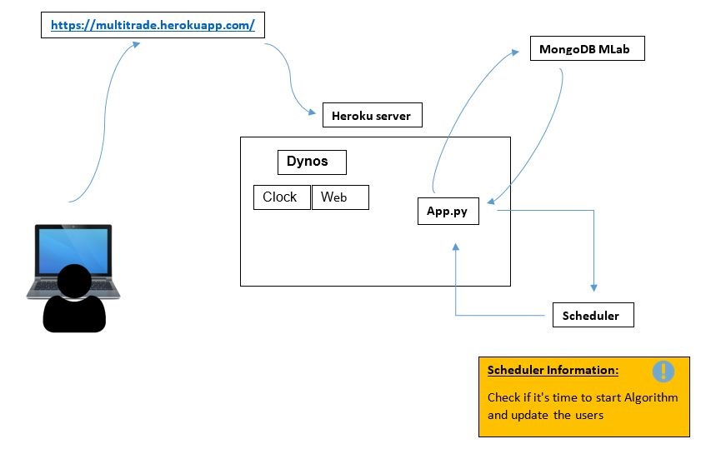
Principles of code design and structure

Slide 5

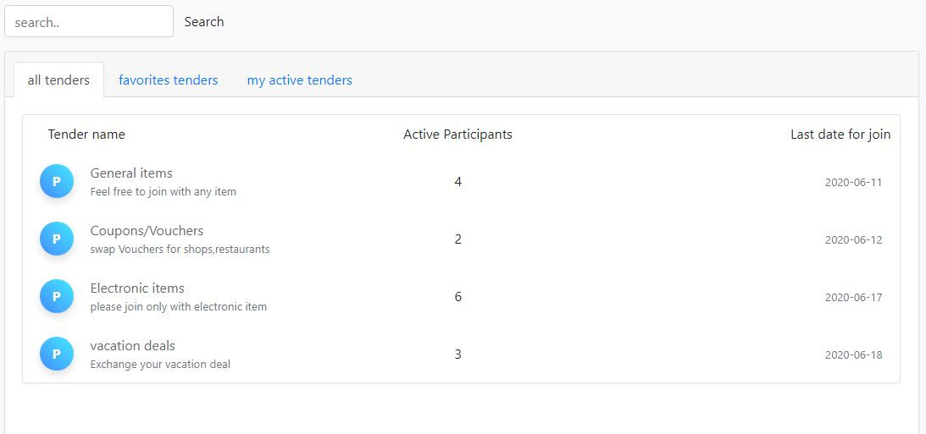
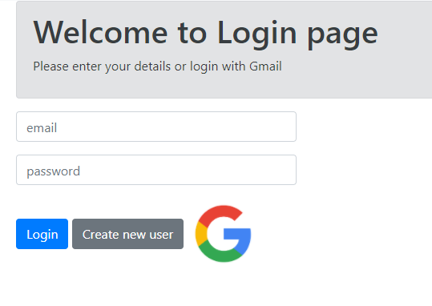
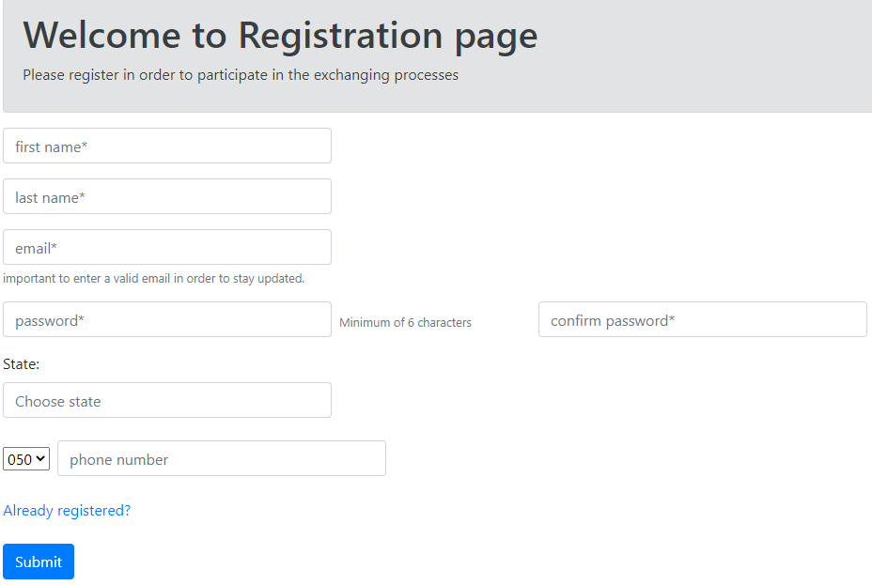
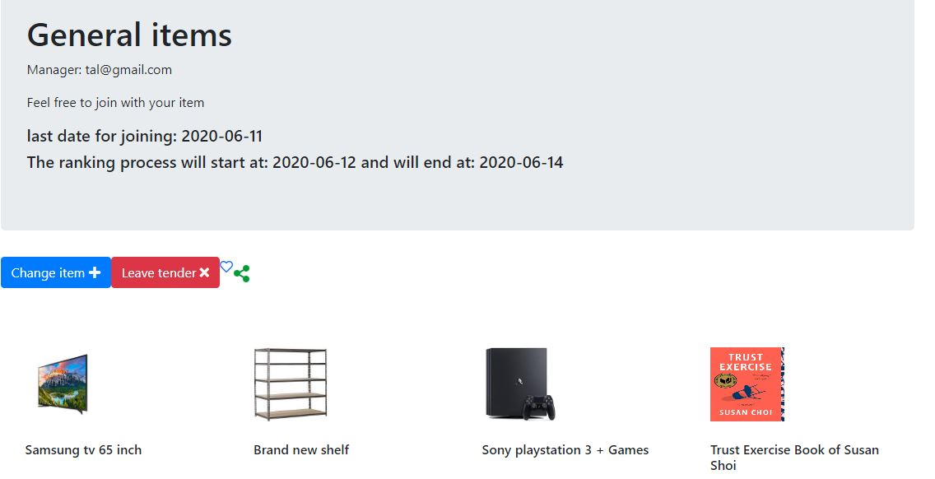
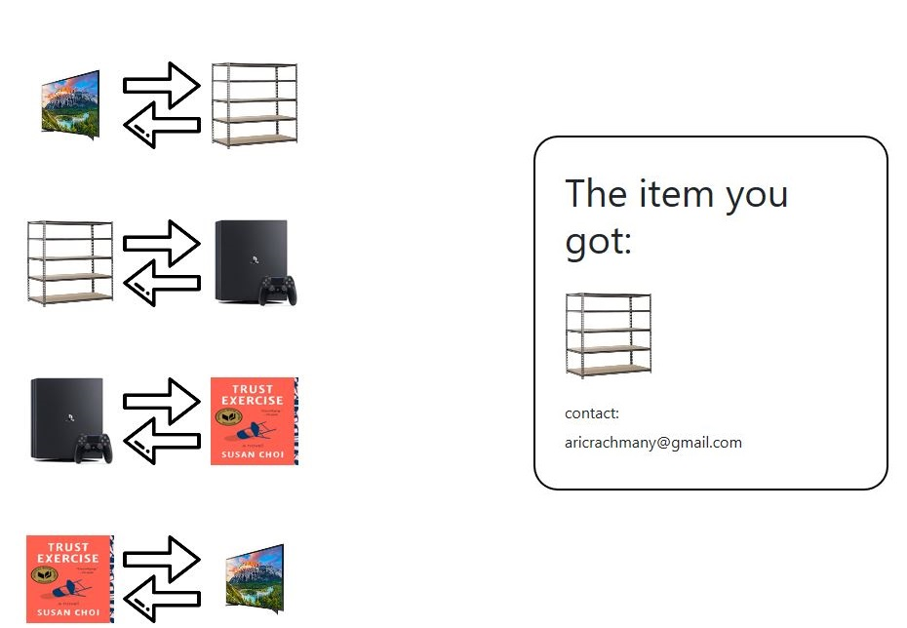
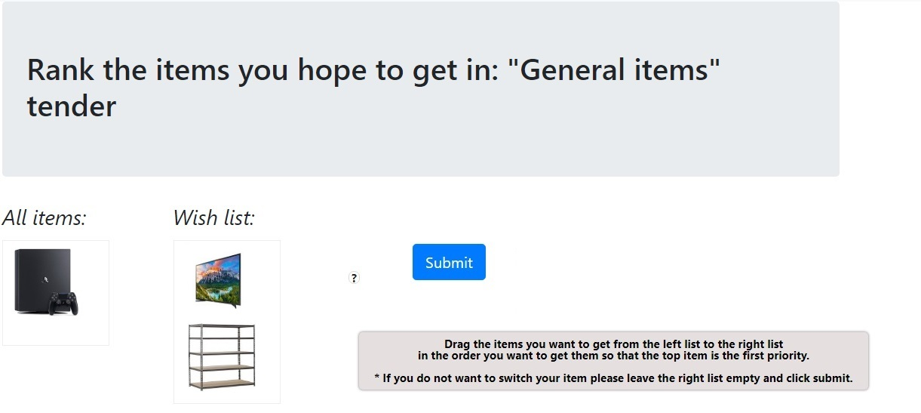
Choose tender
Register
Login
Rank
Results

Slide 6
Our work
Teamwork:
In-depth planning of the project, coordination of expectations with the lecturer and the team members.
Defining the problem, the various solutions, creating a prototype (screenshots and explanations of what the site will look like).
Initial division of work - At the beginning of the work on the project, after the planning stage we spent about a week learning about the various tools that can be used for the project and especially about the server-side work environment and the most appropriate and convenient data structure for our project.
Individual work:
Aric:
Was responsible for implementing the pages as well as writing Python code on the client side, displaying the data from DB within the HTML pages.
Tal:
Was responsible for learning and bringing features that have improved our project in terms of user convenience as well as options for sharing via WhatsApp, logging in through GMAIL and sending emails regarding updating users about the state of the tenders in which they participate, tooltip, calendars and more.
Insights of the project :
Following the project and the experience we gained, we were exposed to the great importance of the planning stages.
Unlike previous projects, a lot of time was invested in everything related to project planning, goal setting and viewing as well as prototype preparation and as a result the code writing phase became faster and less time wasted on changes.
In addition, we learned how to take an algorithm that has been studied theoretically and create a convenient user interface that allows people to enjoy the many benefits that the algorithm has to offer, and we also discovered the challenges involved.
Emphasis on user convenience and safety in everything related to the access of different users to the site.
We improved the ability to work in a team and learned how to divide the work better.
Because this is a complex project, we could not fully perform together step by step and had to divide the work to operate efficiently and meet the schedule allotted to us.

